Slide 1
Advanced Techniques with Large Language Models Lecture 9
Northeastern University
College of Engineering
Multidisciplinary Graduate Engineering Department
INFO 6105 – Fall 2024
Instructor: Abdolreza Mosaddegh

Slide 2
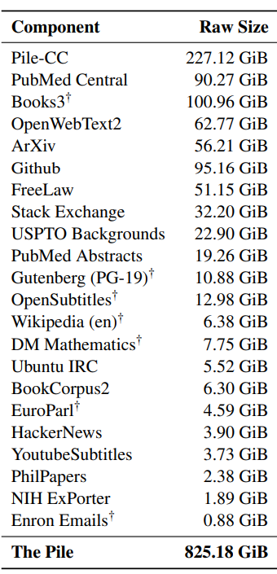
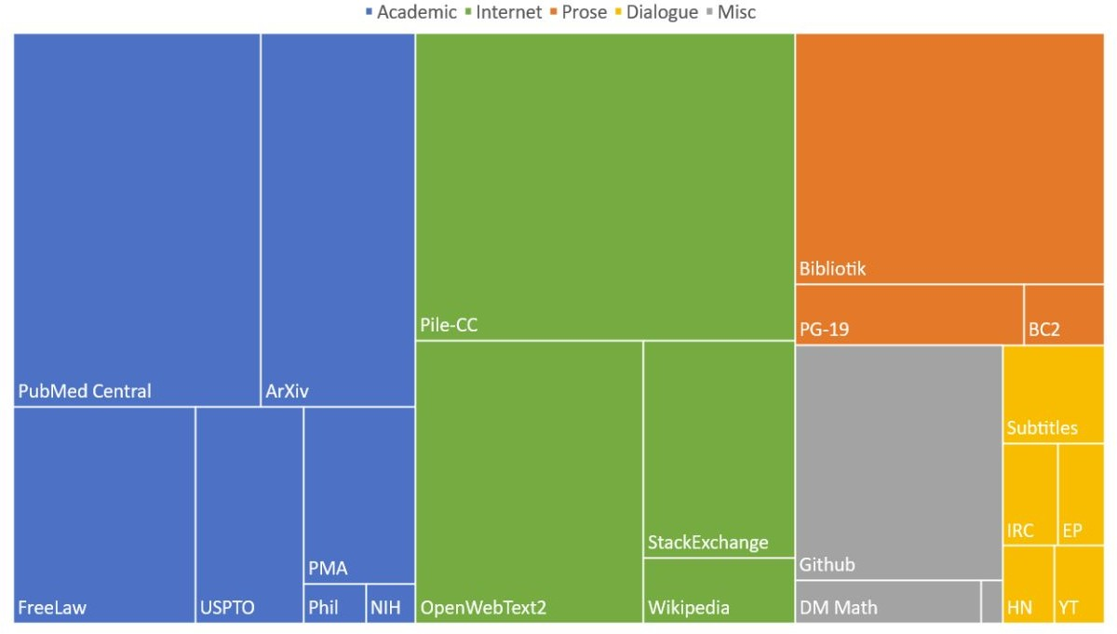
LLMs Pretrained on Huge Information
The data used to pretrain LLMs are huge
The Pile is a dataset for pre-training LLM containing 22 diverse data sources: 800GB total
New commercial LLMs are pre-trained on more data (up to trillions of tokens, e.g., 2 trillion tokens in LLaMA 2)
Wikipedia
~16GB
Question:
Can LLMs store knowledge of this huge data used for training?

Slide 3
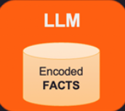
LLM as Model vs LLM as Knowledge Base
AI as a Model:
Learns patterns in data to perform tasks like classification, regression, etc.
Data / factual information are sorted in data sources (e.g., traditional database) and are processed by the model
AI as a Knowledge Base:
LLMs can also approximate a knowledge base, particularly when it is trained on extensive, factual datasets

Slide 4
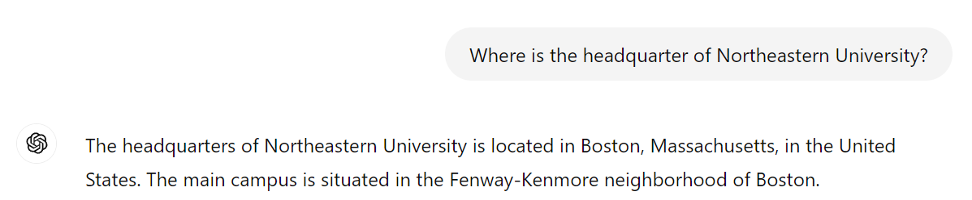
Emergent Abilities of LLMs – Knowledge Base
LLMsʼ ability to store information is recognized during recent years
Early LLMs, such as GPT-2, showed some capacity for this, but GPT-3 (2020) highlighted the potential of LLMs to serve as a knowledge repository
Before that, traditional knowledge bases / data sources were used for storing information
GPT-4 Zero-shot Knowledge Retrieval

Slide 5
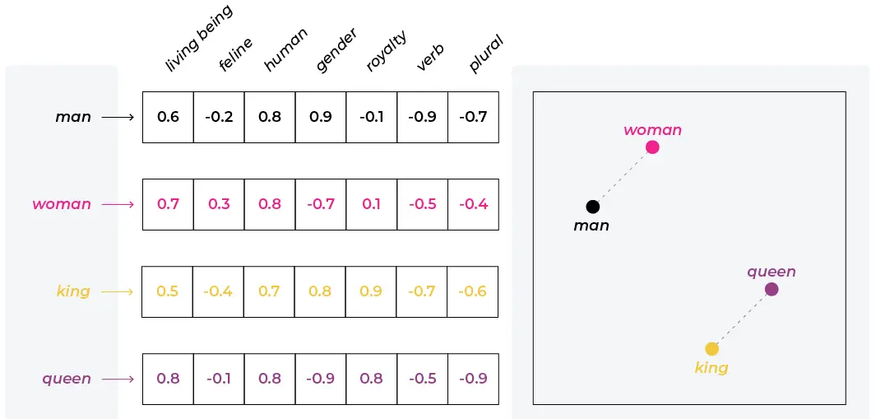
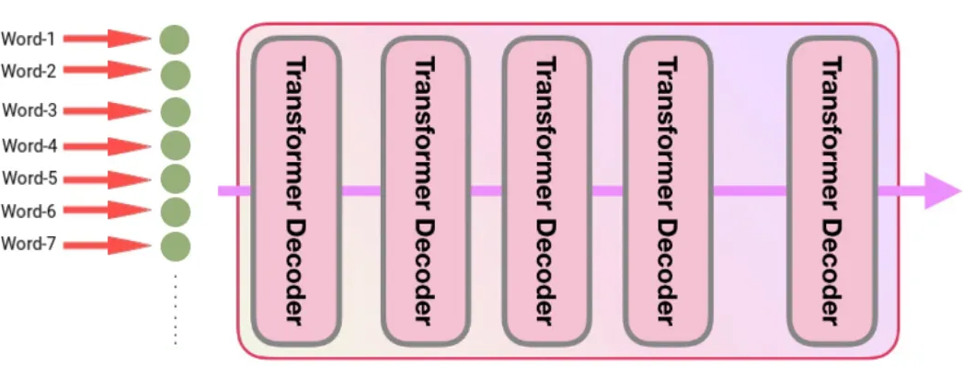
LLMs – Primary Sources of Information
Embeddings(Input Information):
Word embeddings are vectors which encode semantic information of words and capture their semantic meaning and relationships with other words.
LLMs can use embeddings of textual inputs to extract contextual information
Neuron Weights (Internally Encoded Information):
The information in the model's weights is implicit, meaning it is not stored as discrete facts or easily accessible data points.
This internally encoded information makes the LLMs knowledgebases

Slide 6
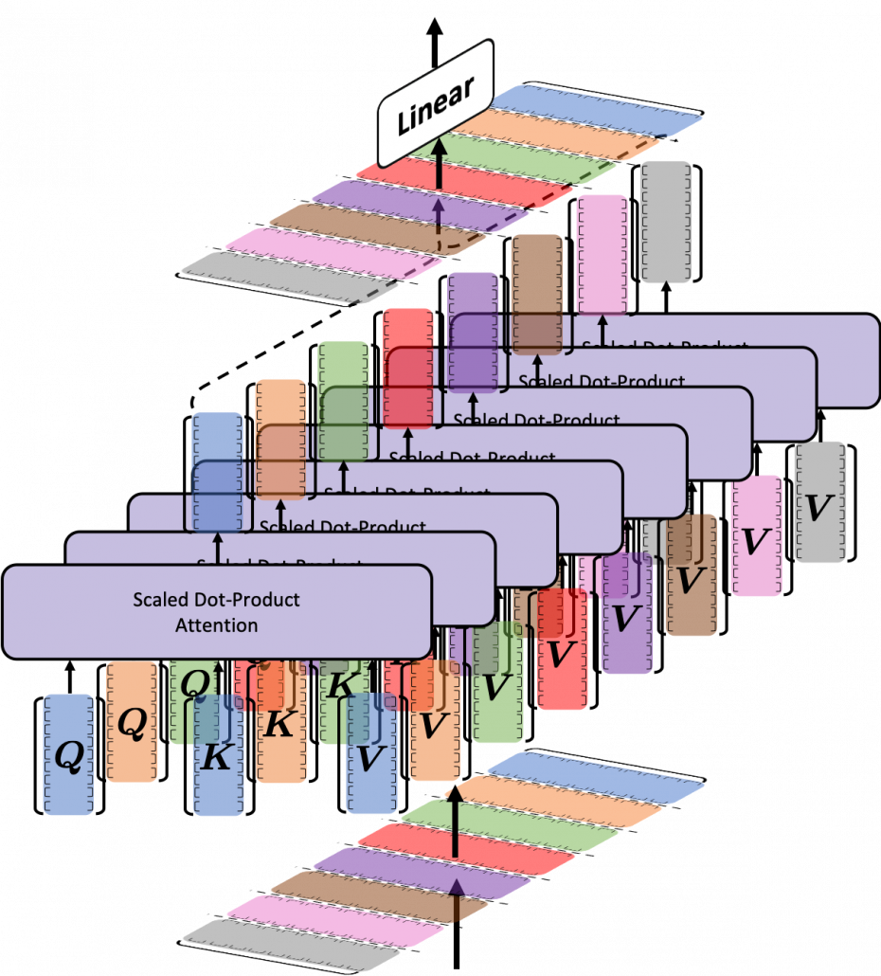
Weights Contain Information
Weights of neurons in LLMs contain information in a distributed manner:
Structural Patterns:
During the training, self-attention adjusts its weights to capture the patterns found in the vast amounts of text. e.g., syntactic patterns
Contextual Relationships:
Self-attention is trained to adjust weights for extracting relationships of embeddings
e.g., trained on “Paris is capital of France” ,
the concept of "Paris" being the capital of "France" isn't stored as a single piece of data but is distributed across many weights

Slide 7
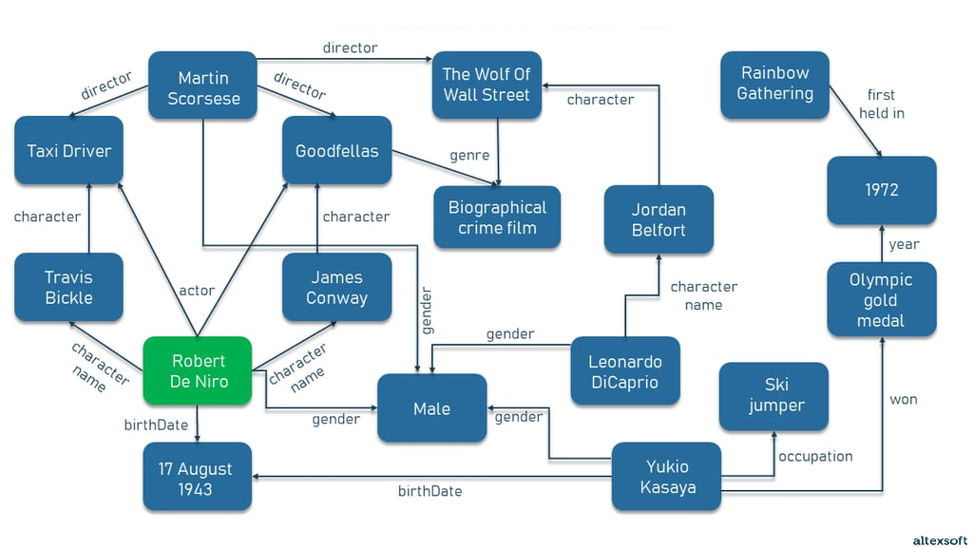
Traditional Knowledge-Base
A centralized repository of structured information or data that can be used to answer queries, support decision-making, or provide insights.
Conceptual knowledge graph
Edges
Relations between entities
Nodes
Entities / classes

Slide 8
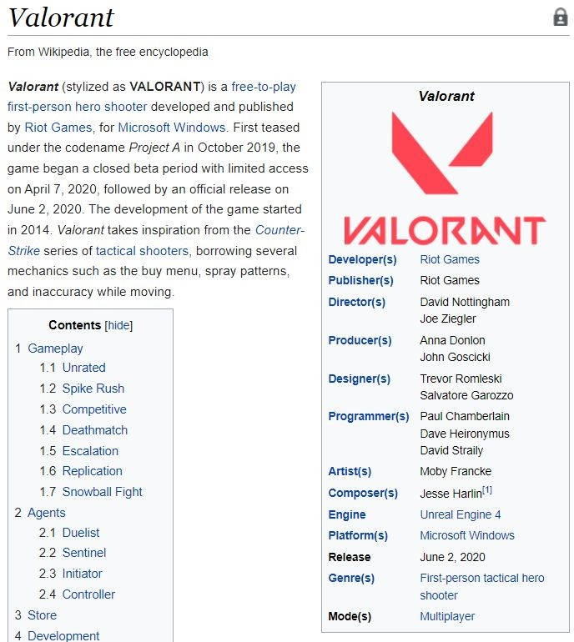
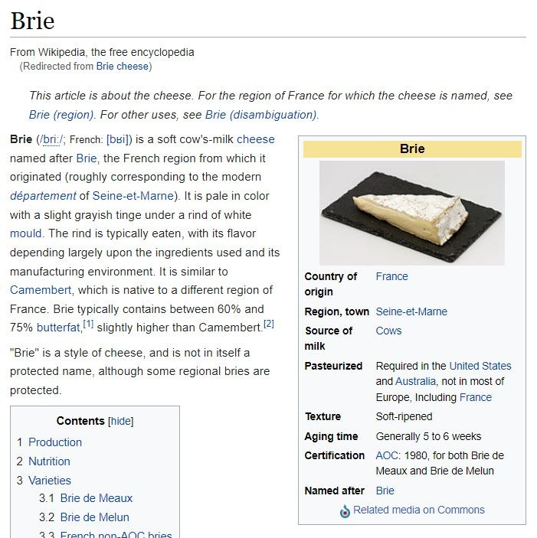
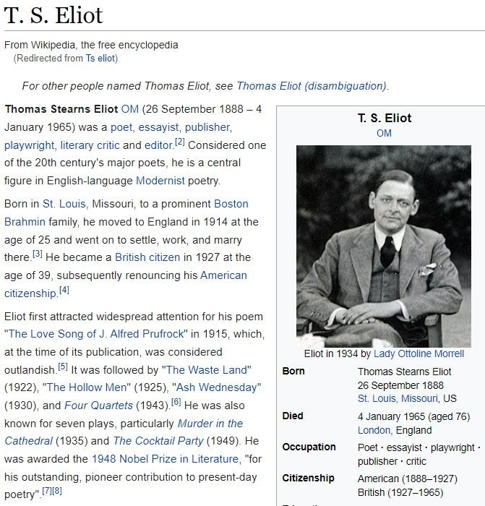
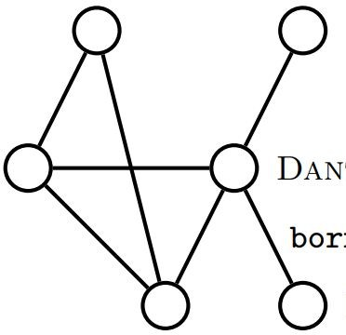
Limitations of Knowledge-bases
Usually not ﬂexible with natural language queries
Developing the knowledge base often involves multi-step knowledge extraction
Structured Queries
Knowledge Extraction Pipeline
Data preprocessing Data merging
Entity/relation extraction Ontology extraction
. . .
unstructured text
knowledge base

Slide 9
Knowledge Extraction
Requires to convert unstructured to structured data to ﬁll the knowledge base
Usually require signiﬁcant manual eﬀort (not scalable easily)
Prone to error propagation (from human annotations or knowledge extraction)
Boston
unstructured text
BORN-IN
Knowledge Extraction Pipeline
T.S. Eliot
(T.S. Eliot, BORN-IN, Boston)
incorrect extraction

Slide 10
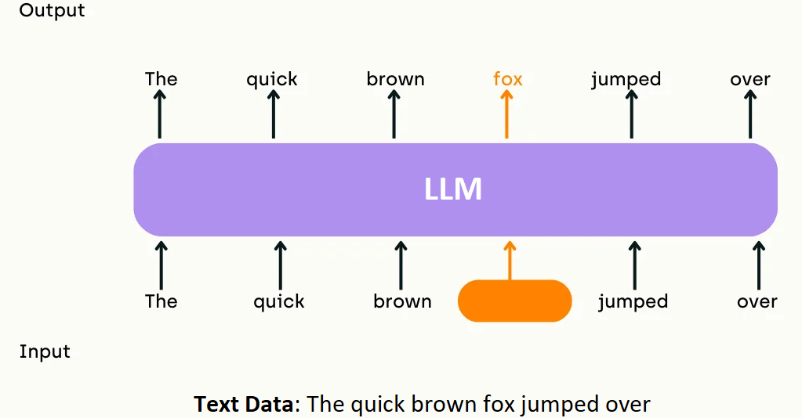
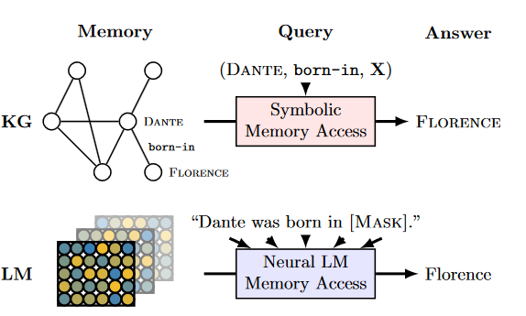
LLMs Advantages as Knowledge Bases
LLM can be pretrained on huge unstructured data using self-supervised approach
Self-supervised doesn't require manual annotations/supervision
LLM are more ﬂexible with natural language queries

Slide 11
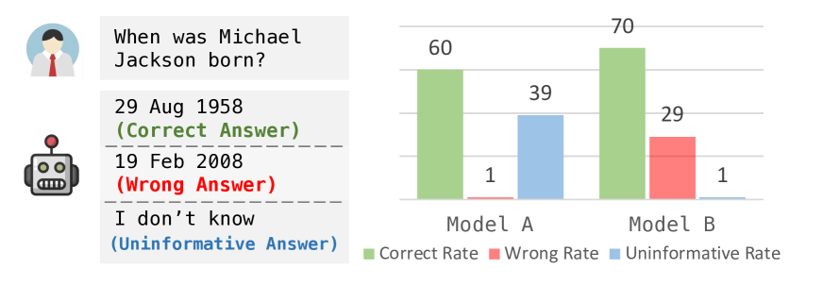
Evaluation of Knowledge Storage in LLMs
Goal: Evaluation factual knowledge storage in pre-trained LLM
Collect set of knowledge sources containing set of facts
Train LLMs on the knowledge sources
Evaluate model to see how well the modelʼs knowledge captures these facts
Evaluation Method on a Particular Fact:
Given a text that queries the model for a missing factual data
Knowledgeable LLMs rank ground truth tokens high and other tokens lower

Slide 12
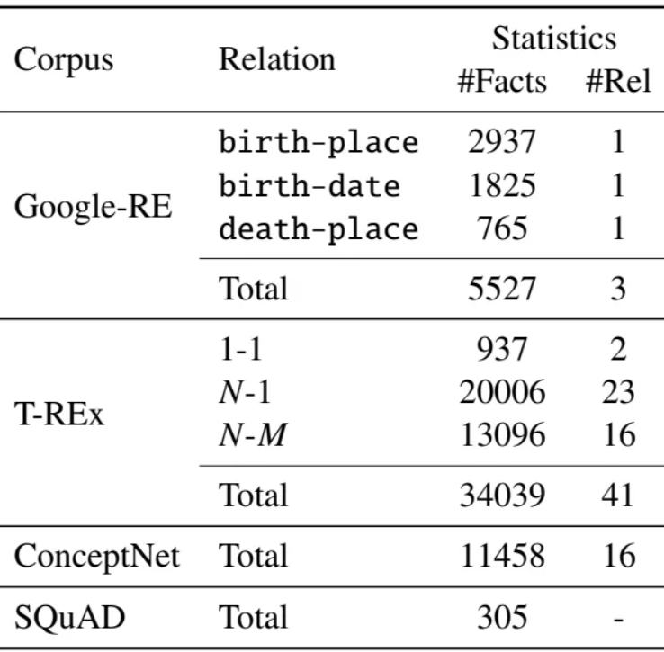
LAMA Probe
LAMA (LAnguage Model Analysis)
A framework used to evaluate the factual knowledge stored within LLMs
Test how well a model can recall factual information that it has been trained on, without relying on external sources or prompting (e.g., few-shot learning).
Dataset:
The LAMA Probe uses a set of factual data, typically derived from knowledge bases like Wikipedia, to create a series of cloze statements.
Evaluation:
The accuracy of the LLM’s responses is evaluated against the correct answers in the dataset.
https://arxiv.org/pdf/1909.01066

Slide 13
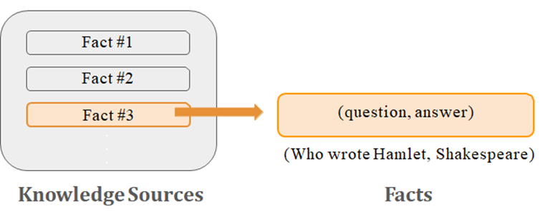
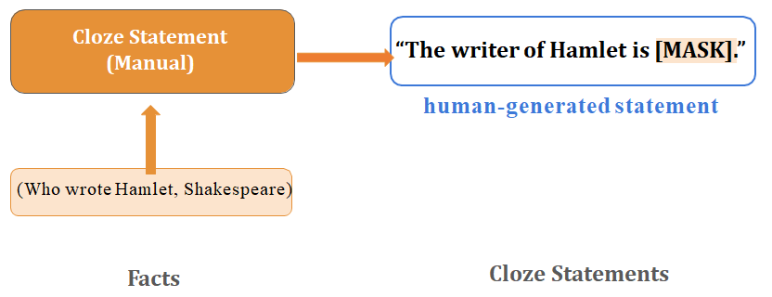
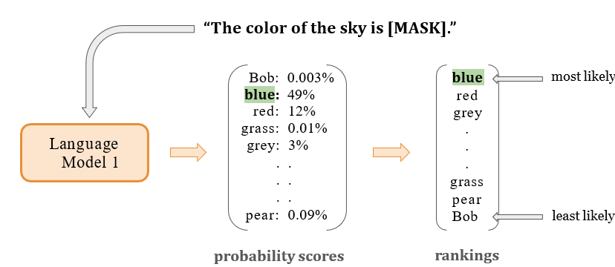
LAMA Probe
Step 2: Create cloze statements
Step 1: Extract facts into question-answer pairs
A cloze statement, is a type of assessment in which words are removed from a passage of text, and the model is required to fill in the blanks
Step 3: Test knowledge of LLMs
knowledgeable LLMs rank correct tokens high

Slide 14
Evaluated Models
Several language models besides traditional knowledgebases of REn (a relation extraction with naive entity linking) and REo (oracle entity linking) were tested
Model |  | Base Model | Training Corpus | Size
fairseq-fconv (Fs) |  | ConvNet | WikiText-103 corpus | 324M
Transformer-XL large (Txl) |  | Transformer | WikiText-103 corpus | 257M
ELMO | ELMo (Eb) | BiLSTM | Google Billion Word | 93.6M
 | ELMo 5.5B (E5B) |  | Wikipedia + WMT 2008-2012 | 93.6M
BERT | BERT-base (Bb) | Transformer | Wikipedia (en) & BookCorpus | 110M
 | BERT-large (Bl) |  |  | 340M

Slide 15
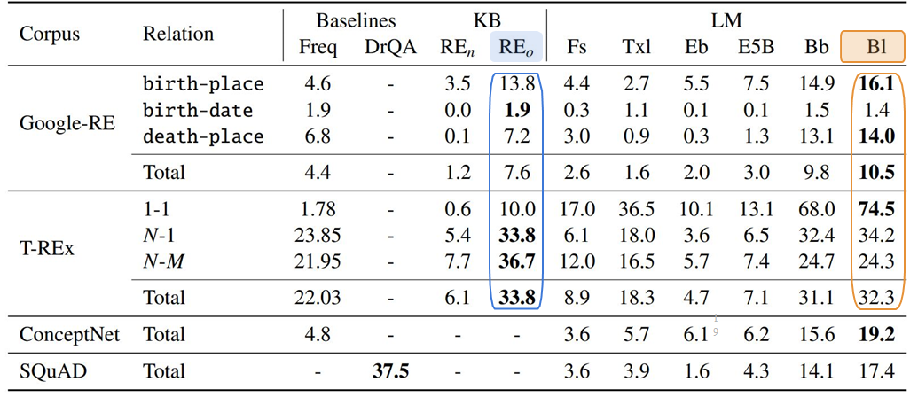
Results of Assessment
BERT-large recalls knowledge better than other networks
BERT-large is competitive with a RE knowledge base that was trained on the best possible data and used the entity-linking oracle
Language models provide a sufficient alternative to knowledge bases
precision at rank 1

Slide 16
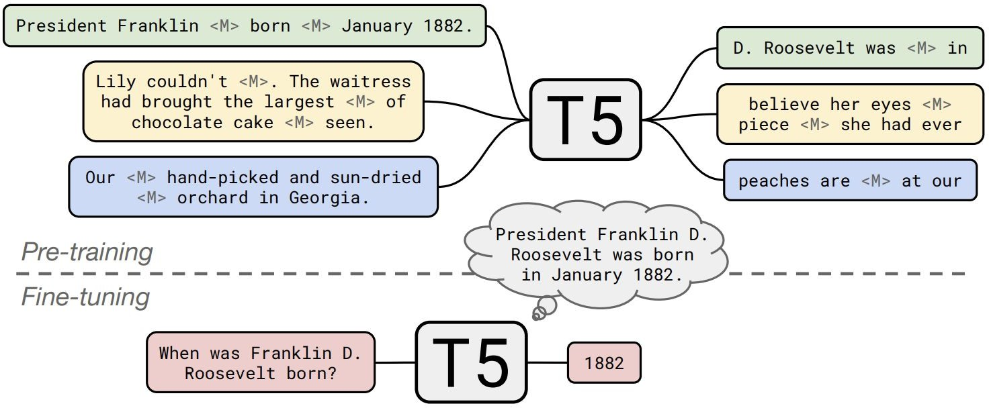
LLMs vs Retrieval Systems
Assessment amount of Knowledge storage in parameters of an LLM:
Assessment of LMMs on question answering without external data comparing retrieval systems.
Investigates if larger models with more parameters can store and retrieve more information.
T5 is fine-tuned to answer questions without any external information or context.
https://arxiv.org/pdf/2002.08910

Slide 17
Settings
Models:
T5 models: Base (220M), Large (770M), 3B (3B), and 11B (11B) parameters.
Retrieval systems which rely on retrieving information from external databases
Datasets:
Natural Questions (NQ)
A dataset containing real web search questions with answers from Wikipedia
WebQuestions (WQ)
Web search questions with answers from FreeBase
TriviaQA (TQ)
Features trivia questions from quizzes
Method:
Retrieval models answer questions using external resources
T5 is fined tuned on datasets then answered questions without external data sources

Slide 18
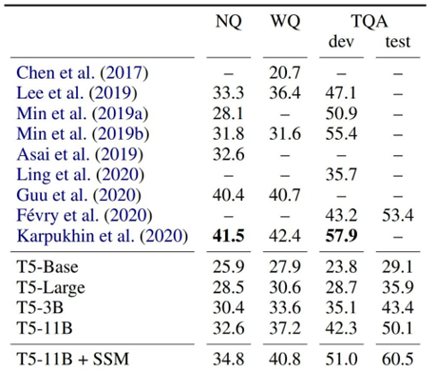
Results
LLMs pretrained on unstructured text perform competitively compared to competitors with access to external knowledge
Scale is critical to performance. More parameters usually mean more knowledge stored within (parameters contain knowledge)
Retrieval-based Models (access external documents)
Models with ﬁne-tuning (relies only on internal parameters)
Metric: Exact Match

Slide 19
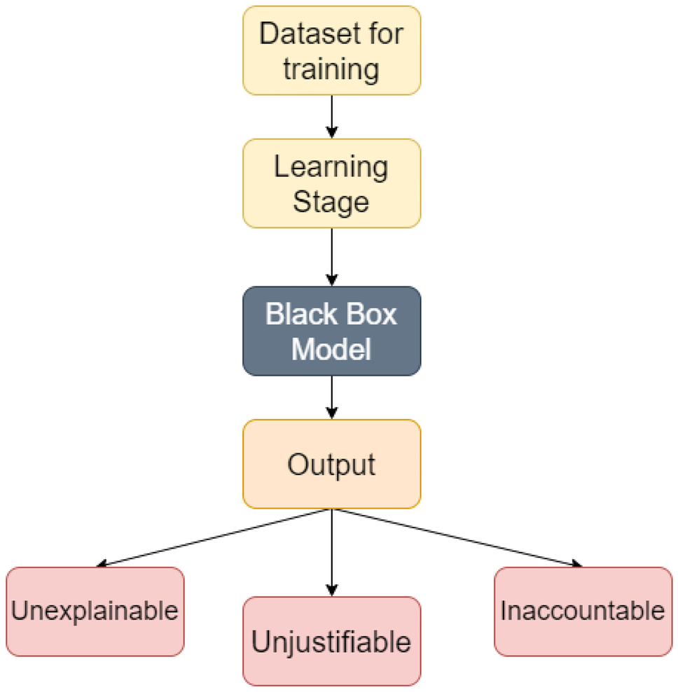
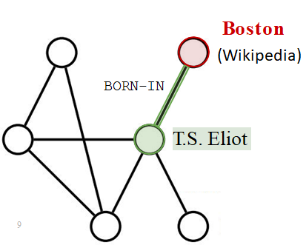
Limitation of LLMs – Lack of Traceability
No Explicit Facts: Transformers encode information in weights (black-box) rather than storing discrete information explicitly like a traditional knowledge base
Source of Facts: Traditional knowledge bases often allow to trace the source of a fact (more reliable) but LLM’s knowledge is distributed across the model's parameters
Training Data Opacity: LLMs are trained on aggregated datasets, making it difficult to pinpoint the exact source of specific information.
Data Mixing: Knowledge from multiple sources may combine into a single response, making individual source identification complex.

Slide 20
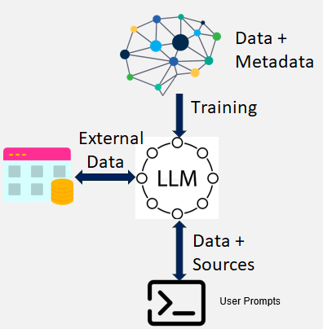
LLM – Improving Traceability
Importance:
Transparency: Provides users with insight into where information originates.
Knowledge Verification: Ensure the model generates reliable outputs based on factual knowledge.
Debugging: Helps to identify errors
Methods:
Training with Metadata: Including source metadata during model training
Citation Mechanisms: Fine-tune models to cite likely sources
Retrieval Methods: Combining LLMs with external knowledge-bases

Slide 21
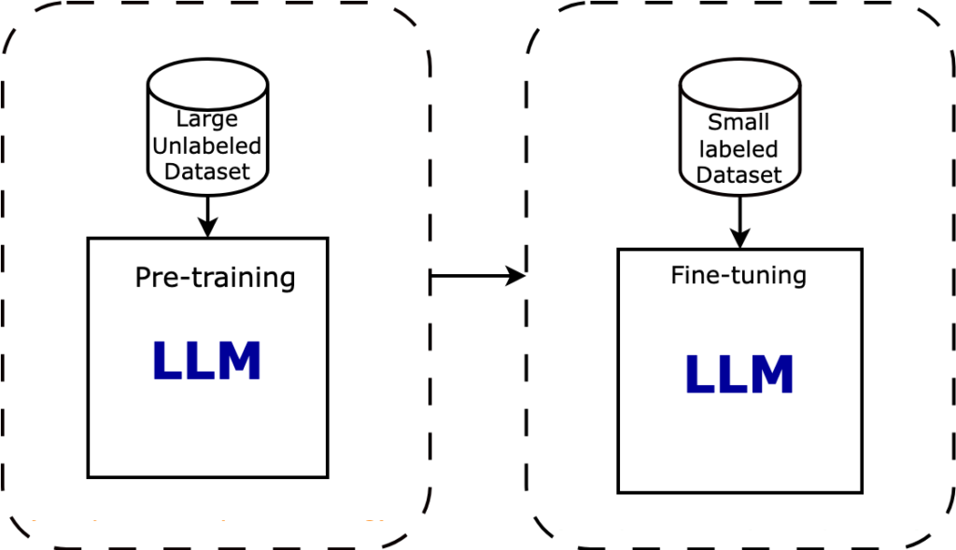
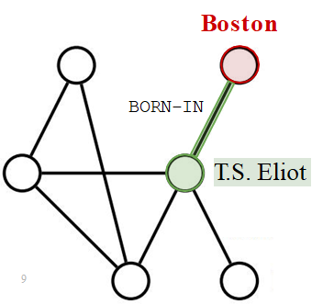
Limitation of LLMs – Information Update
No Updating Mechanism:
After pre-training, the weights of LLMs will be fixed.
Updating the knowledge usually requires retraining or fine-tuning on new data
Much more complex than updating a traditional knowledge base.
Risk of catastrophic forgetting
Solutions:
Knowledge Injection: modifying the knowledge neurons
Retrieval Models : Combining LLMs with external knowledgebases

Slide 22
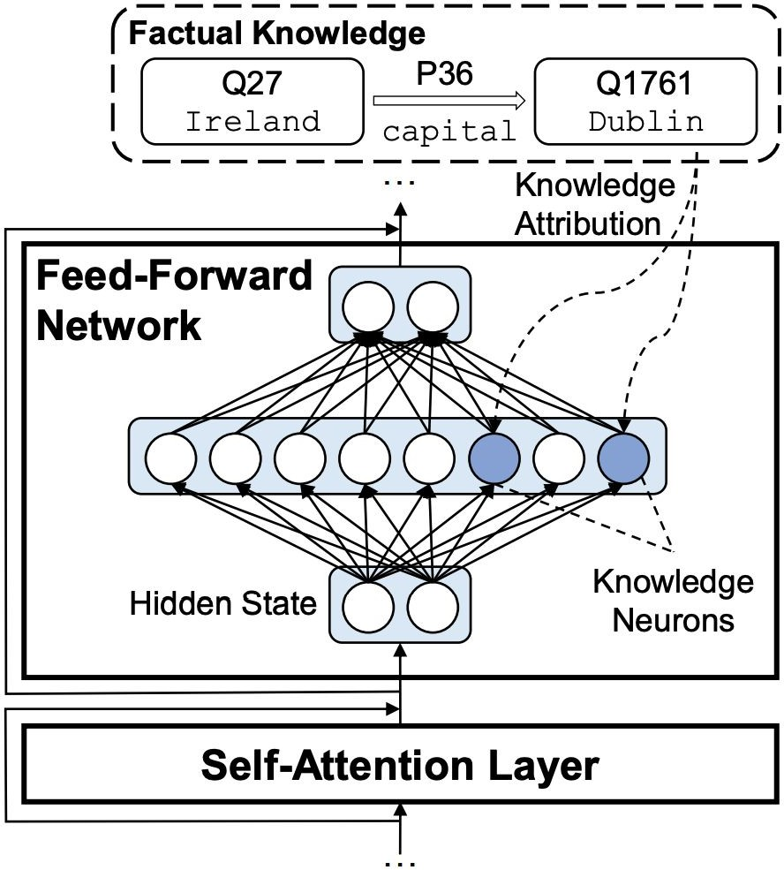
Knowledge Neurons
Some studies on LLMs suggests that some neurons specialize in representing particular facts
Specific neurons within a neural network that encode distinct pieces of knowledge
Certain neurons in an LLM can show a high degree of activation when queried about specific facts, e.g., “Dublin is the capital of Irland."
https://arxiv.org/pdf/2104.08696

Slide 23
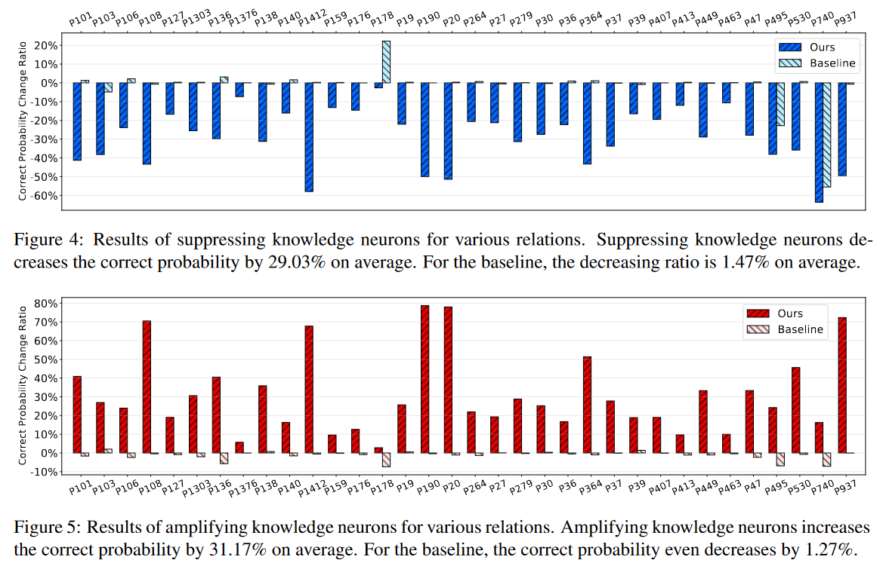
Suppressing or Amplifying Knowledge Neurons
By activating or suppressing knowledge neurons, can observe their impact on model behavior, validating their role in storing specific knowledge.
Suppressing the Knowledge neurons hurt performance and amplifying Knowledge neurons increase performance by up to 30% on average.

Slide 24
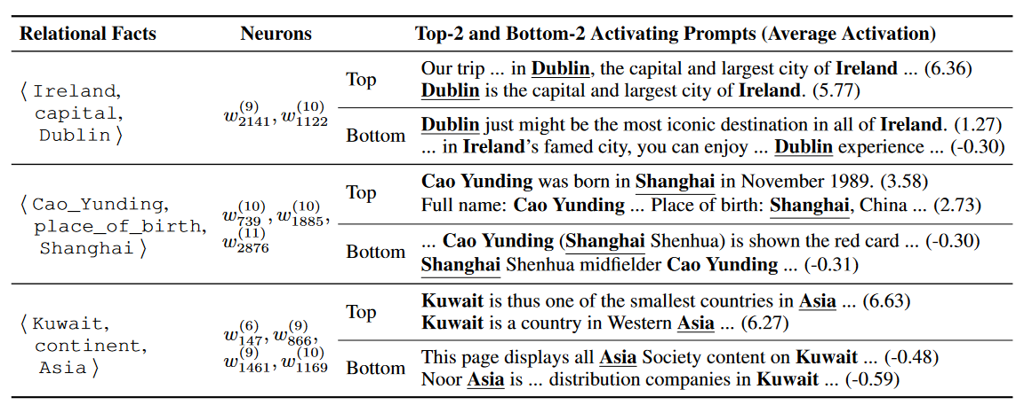
Mapping Knowledge to Neurons
Researchers identified individual neurons that consistently activate when the model processes specific information.
By manipulating these neurons, it's possible to edit the model's knowledge about certain topics without retraining the entire model.

Slide 25
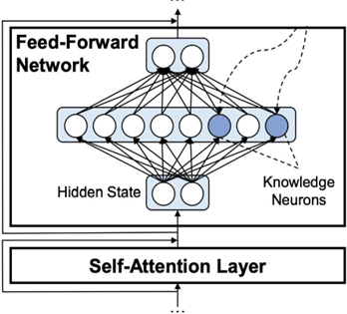
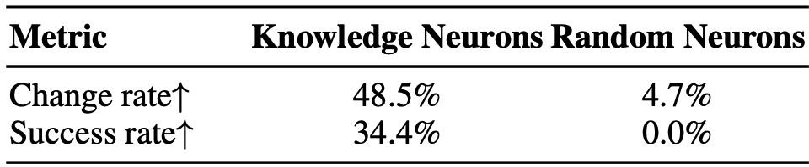
Updating Facts using Knowledge Neurons
Update neuron values by subtracting the embedding of the previous answer and adding the embedding of updated answer
Manipulation of knowledge neurons had a significant impact, while random neurons are insufficient.
Manipulation has little negative impact on other knowledge predictions.
Updating facts using this approach is less expensive than fine-tuning

Slide 26
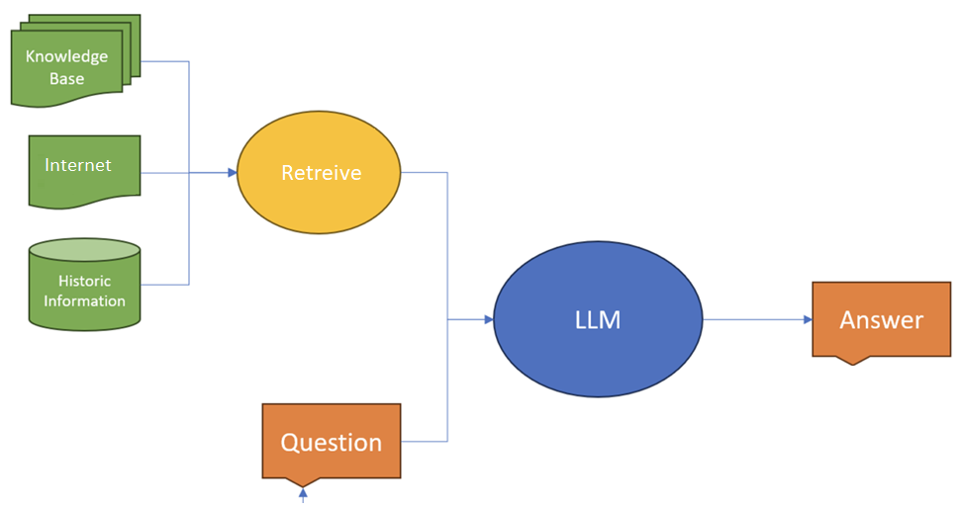
Challenges
Modifying knowledge neurons is still a topic of research and has not yet seen widespread deployments
Adding new knowledge (instead of updating) is challenging and sometimes needs scaling the model
It is not helpful when real-time information is needed:
e.g., "What's the current weather in New York?“
Solution: Retrieve real-time information

Slide 27
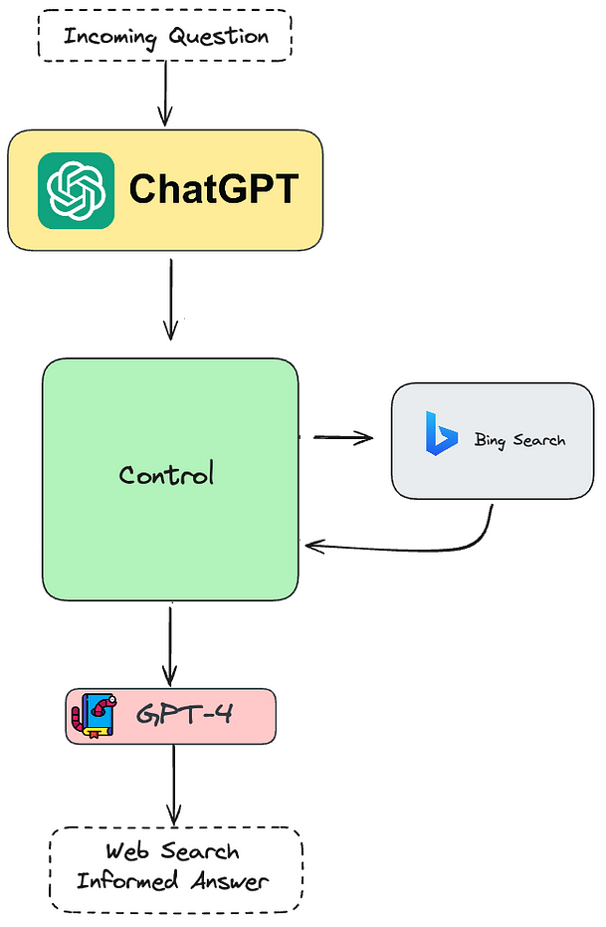
Retrieve Real-time Information
API Integration:
LLMs use external APIs (e.g., APIs of search engines) to search and fetch real-time data from the internet.
Proxy Systems:
A proxy system serves as a middle layer that processes requests from the LLM and retrieves or computes data from external sources.
Retrieval-based Language Models:
Fetch relevant information from a large, often real-time, database updated from internet.

Slide 28
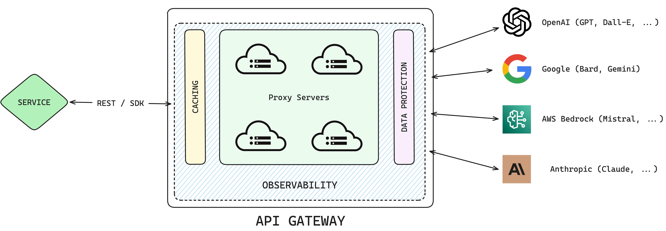
Proxy Systems - Steps
The LLM sends a query to the proxy system based on the user's prompt
The proxy system routes query to the appropriate external source, such as an API, search engine, etc.
Proxy systems can pull data from multiple sources, aggregate it, and process it before returning it to the LLM
Poxy system preprocesses retrieved data into a format suitable for the LLM (e.g., convert JSON result of API to text )
LLM receives information and generate response based on internal knowledge and retrieved information
Example: AWS API Gateway can serve as a proxy for LLMs
OpenAI provides plug-ins for GPT that act as proxies
Problem: Proxy systems cannot interpret semantic context of an LLM query and might return irrelevant responses (e.g., Query on ”value of Apple”)

Slide 29
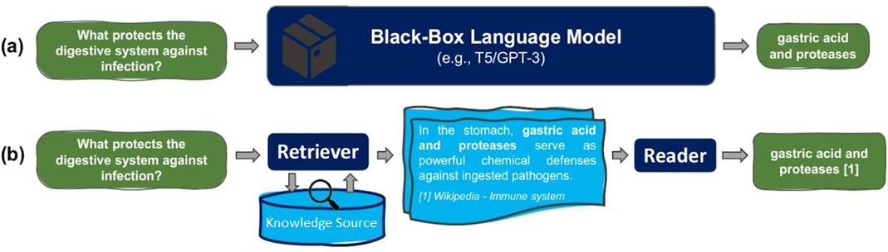
Retrieval-based Language Models
Language models designed to use retrieved external data for crafting response:
Knowledge Source: The repository where information is stored
Retriever: Fetches relevant data points from knowledge source.
Reader (Language Model): Processes the retrieved data and produce a coherent response based on the user’s query
Stanford

Slide 30
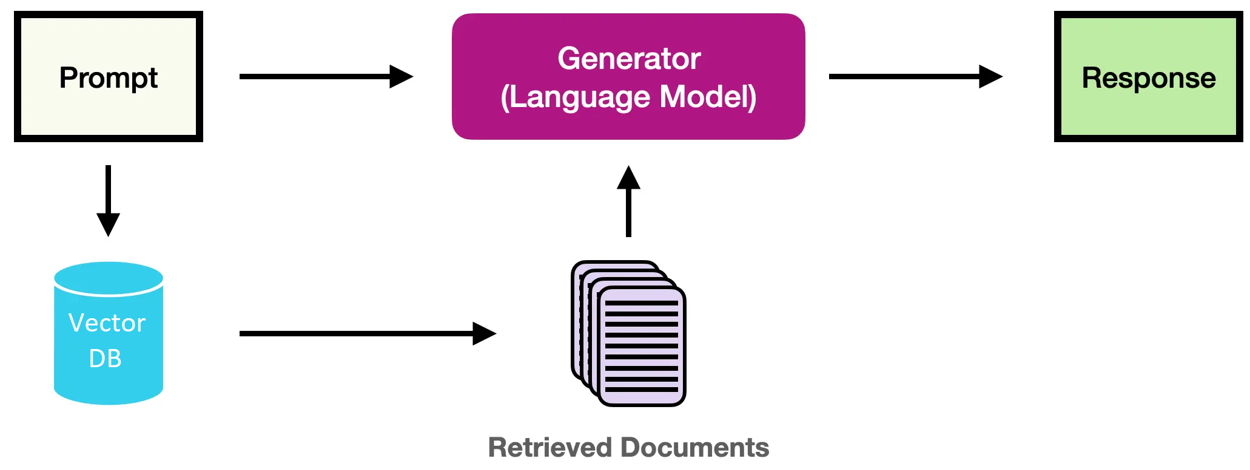
Retrieval-Augmented Generation (RAG)
RAG is one of the most common retrieval-based language models
Meta introduced RAG in "Retrieval-Augmented Generation for Knowledge-Intensive NLP Tasks"
Retrieval Stage
Search and retrieve information relevant to the context of user's prompt
2. Generation Stage
LLM generates response by integrating the retrieved data with its internal knowledge

Slide 31
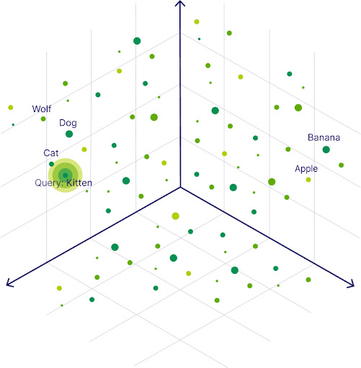
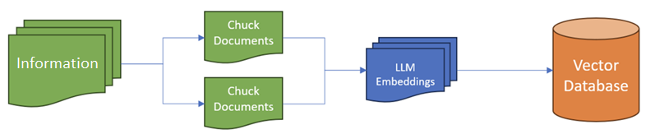
Vector Databases as Knowledge Source
Vector databases store structured and unstructured data alongside their vector embeddings and meta data
A vector embedding encodes the context of a chunk of data (e.g., a sentence)
Retriever searches based on similarity between context of user input (input embedding) and stored vector embeddings
Apple (as company)
Query on Apple depends on context

Slide 32
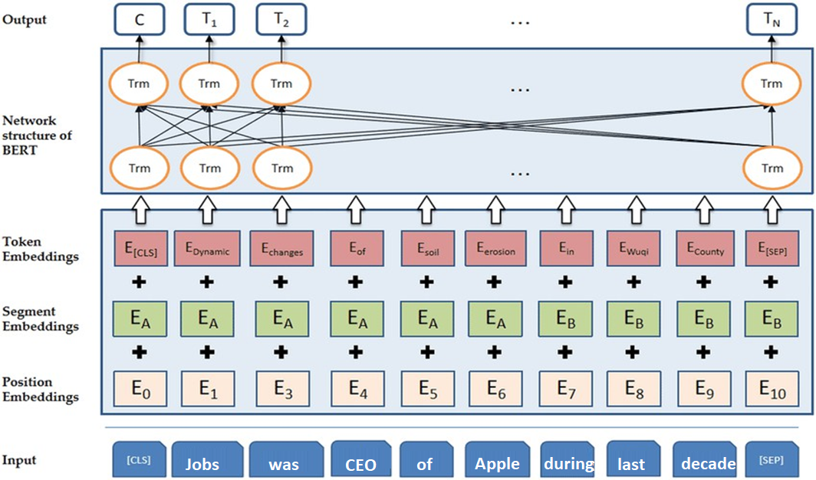
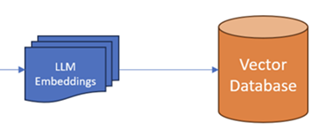
Embedding Model
A transformer with encoder part (e.g., BERT) can be used to create embeddings reflect context of a chunk of data (e.g., context of a sentence)
Context Vector (The [CLS] token capture the context of the sequence by attending to all other tokens)
Context Vector

Slide 33
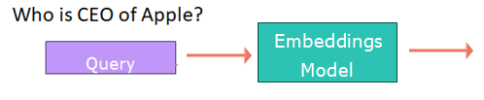
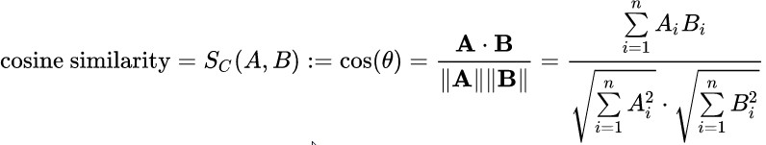
Retrieve Relevant Data
Uses a variant of the KNN (Approximate NN) to search for a query in vector DB:
Comparing embeddings of the query with all embeddings using Cosine Similarity
Sorting them by similarity
Fetch the data (e.g., text) of the top K similar embeddings
Vector DB Similarity
Emb. 1
0.3
Emb. 2
0.1
Emb. 3
0.2
…
0.4
…
0.0
Keep top K
Query (Emb.)
…
0.1
Retrieving only a single document might not provide enough information
…
0.2
…
0.6
Emb. 999,998
0.9
Emb. 999,999
0.2
Emb. 1,000,000
0.7

Slide 34
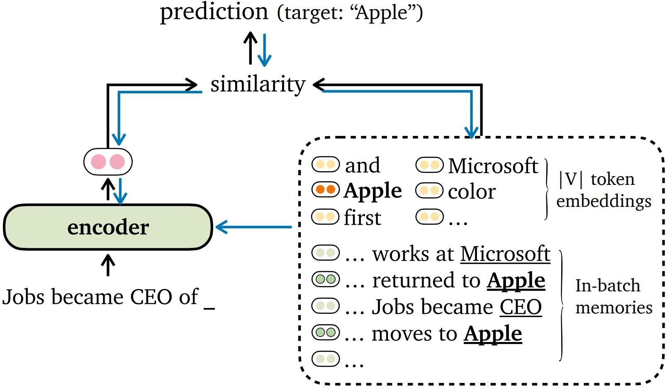
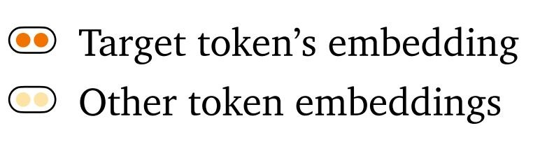
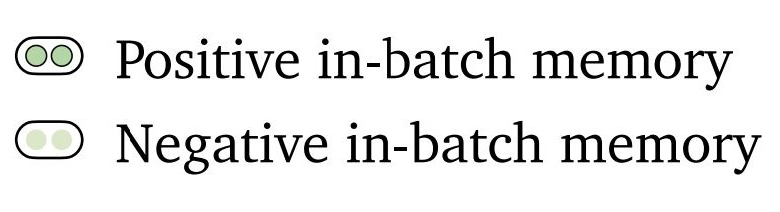
Variants of RAG - RAG-Token
LLM analyzes user query generates a token.
Retrieves the most relevant information to the context of generated token(s)
LLM uses retrieved data, user query, and generated tokens to predict next token
Repeats 2 and 3
Problem: Computationally expensive
User Query:
When did Jobs become CEO?
LLM Response:

Slide 35
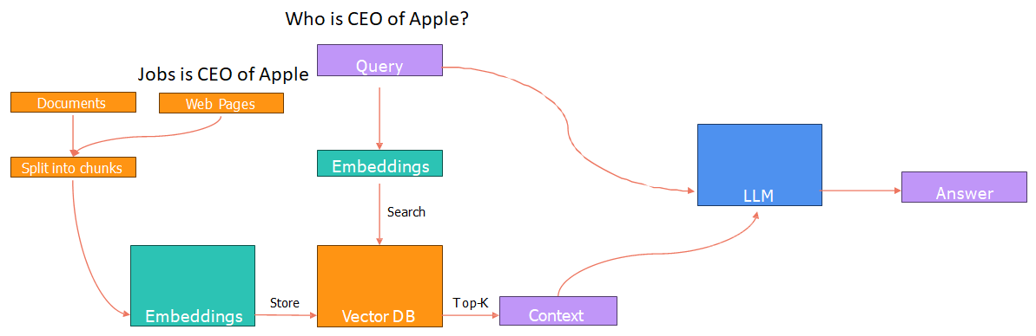
Variants of RAG - RAG-Sequence
Retrieves the most relevant information in vector DB to the context of user query (embedding of query)
LLM uses retrieved data and user query to generate entire response

Slide 36
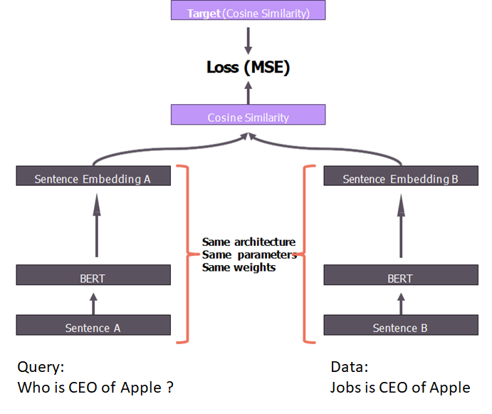
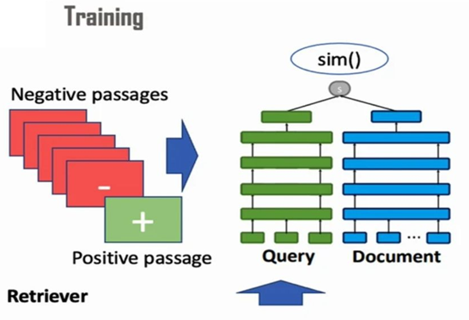
Training
An encoder transformer (e.g., BERT) can be used for encoding context of data into embeddings using self-attention mechanism
Use the [cls] token as sentence embedding.

Slide 37
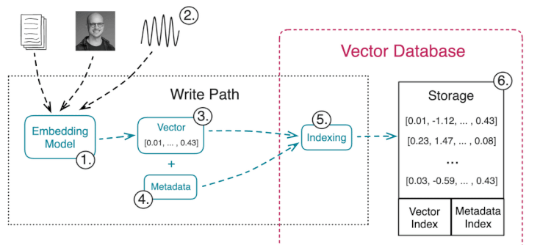

Advantages of Vector Databases
Dynamic Knowledge: provides real-time / near real-time information
Efficiency: don’t need huge number of parameters to encode all data, hence, models can be much smaller and faster
Context-Aware: finding information with similar context, making the retrieval highly contextual.
Multi-Model: data can be any modalities, such as images, audio, or even their combinations besides their meta-data
Traceability: sources retrieved by the model can be inspected, which is more reliable
External Knowledge: Vector DB provides factual knowledge outside of pre-trained knowledge which avoids hallucinations

Slide 38

Limitations of LLMs - Hallucination
Hallucination is generated information by the model that is factually incorrect, nonsensical, or not grounded in the data it was trained on.
LLMs are trained to predict the most probable next word based on patterns learned from a vast amount of text data.
LLMs weights are locked after training (pre-training and fine-tuning)
If the query is about a new information or information not existed in training data, the most probable words can be an incorrect answer

Slide 39

Types of Hallucinations
Factual: The model may invent details, such as attributing a quote to the wrong person, making up historical events, or providing incorrect statistics.
Logical: The model might generate text that defies logic or common sense, such as contradictory statements within the same response.
Contextual: The model might provide information that doesn't fit the given context, either by misunderstanding the prompt or by pulling in unrelated data.
A study shows that 55% of the GPT-3.5 citations and 18% of the GPT-4 citations are fabricated.
Fake Reference
https://www.nature.com/articles/s41598-023-41032-5

Slide 40

Causes of Hallucination
Training Data Limitations: LLMs are trained on vast but finite datasets, which can be incomplete, outdated, or contain errors.
Ambiguity in Training Data: If the training data contains conflicting examples or gaps, the model may generate inconsistent outputs for related queries.
Prompt Ambiguity: If the input prompt is vague or open-ended, the model might generate an incorrect response.

Slide 41


Mitigating Hallucinations
Refining Prompts: Providing clear, specific prompts can reduce ambiguity and guide the model towards more accurate responses.
External Knowledge Sources: Incorporating retrieval models can help ground the model's responses in fact, reducing the likelihood of hallucination.
Post-Processing Checks: Implementing tools / agents to verify the model's output against reliable sources can help identify and correct hallucinations.

Slide 42

Multi-Agent Systems
Autonomous agents working collaboratively to achieve complex tasks
Specialization: Specific roles or tasks they are optimized to perform.
Autonomy: The ability to operate independently.
Collaboration: Coordination with other agents to achieve shared goals.

Slide 43

Multi-Agent - Components
Agents:
Task-Generating Agents: Responsible for breaking down goals into subtasks (e.g., project planners or question breakdown agents).
Task-Solving Agents: Specialized agents handling specific subtasks (e.g., summarization, information retrieval, or translation).
Evaluation Agents: Responsible for quality control, checking correctness, coherence, or relevance of results.
Communication Protocols:
To facilitate interactions between agents

Slide 44


Multi-Agent - Advantages
Accuracy and Reliability: Multi-agent systems help solve this problem by letting agents check each other's work
Efficiency and Multitasking: Multi-agent systems improve efficiency through parallel processing, where several agents handle different tasks simultaneously.
Example: Code Generation
Code Executer Agent
Code Developer Agent

Slide 45


AutoGen
Customizable AI agents that collaborate to complete complex tasks, each specializing in roles such as a writer, critic, or user proxy (Microsoft)
AutoGen's novel interactive retrieval feature that enhances retrieval attempts

Slide 46

Limitation of LLMs - Instability
Sensitivity to Input:
In traditional (structured) knowledgebases the results of queries are stable
Small changes in prompts or minor rewordings (different embeddings) can yield significantly different results (uncertainty in results)
Sensitivity to Decoding Settings:
Different parameters of temperature, K(Top-k) and
P(Top-p) have impacts on responses / stability
Non-reproducibility:
In traditional knowledge / data bases structured query languages are used
LLM responses to identical queries can vary due to the probabilistic nature

Slide 47

Mitigation of Instability
Adjusting Decoding Parameters:
E.g., use a Low temperature, K (top-k), P (top-p)
Knowledge Retrieval Methods:
Integrating the model with external knowledge sources, such as databases or search engines
Integration Methods:
Involves combining the outputs of multiple models to improve the overall stability, and accuracy of the system (e.g., ensemble models)

Slide 48

Mixture of Experts
MoE in LLMs is typically implemented by dividing the model into multiple expert modules trained to handle a specific subset of the input
A gating mechanism that selects which experts to activate for each task.
Gating network outputs a weighted combination of the experts’ outputs.
MoE model would have experts specializing in technical texts, creative writing, coding, etc.

Slide 49

Switch Transformer
A highly scalable LLM using sparse MoE layers (activates a small portion of total parameters ) introduced by Google
only one expert is activated per token at each layer, which is determined by a learned routing function.
Supports models with up to 1.6 trillion parameters, making it one of the largest models ever developed.
Despite its size, the inference cost is comparable to smaller dense models, since only a small fraction of the model is activated for each input
https://arxiv.org/pdf/2101.03961

Slide 50

Challenges of LLMs - Memorization
The ability of LLMs to store and recall specific pieces of information from the data they were trained on using a semi-supervised approach.
If the model memorizes a specific phrase that contains private / sensitive data, it could inadvertently expose that information during use.
An example of memorization is when the model generates text that is a near-exact reproduction of specific content from its training data
LLM might produce a response that closely mimics a paragraph from the copyrighted text.

Slide 51

Memorization Probe
LLMs predicting better on datasets seen during training, indicating that memorization leads to overfitting.
Small re-formatting also leads to an average accuracy drop of 6 percentage points on the memorized datasets.
Mean Relative Error (%)
https://arxiv.org/pdf/2404.06209
Predicting financial time series with GPT-3.5 and GPT-4 exhibits remarkable performance differences between years prior to and after 2021 (the cutoff of the training)

Slide 52

Memorization - Mechanism
Frequent Data: When a model "memorizes" something, it's often because that piece of information was repeated frequently in the training
Overfitting: When a model is excessively trained on a small or unrepresentative dataset, it may start memorizing specific instances instead of learning patterns
Model Capacity: If the model's capacity is primarily used for memorizing specific data points rather than learning generalizable patterns, it cannot generalize well.

Slide 53

Mitigation Strategies for Memorizing
Remove Sensitive Information: Pre-process the training data to identify and remove sensitive information.
Avoid Overfitting: Techniques like dropout during training which reduce the likelihood of memorizing specific patterns.
Synthetic Data Generation : Creating synthetic data that reflect characteristics of real data
Reduce Parameters: Reduce parameters of model in over-parameterize model, reduce the model's tendency to memorize specific details.

Slide 54

Over-parameterize Models
Not all weights in a large language model (LLM) are strictly necessary to achieve high-quality performance.
It’s possible to prune, quantize, or distill weights with minimal impact on performance of the model
Quantization: Quantization reduces the precision of the weights (e.g., 8-bit integers instead of 32-bit floats)
Distillation: In model distillation, a smaller model learns to mimic the output of the larger model
Pruning: This involves removing weights that contribute minimally to the model's predictions

Slide 55


Quantization
Post-Training Quantization (PTQ):
Model is trained using full precision (e.g., 32b), then quantization is applied.
Commonly used for static models where retraining isn't feasible.
Quantization-Aware Training (QAT):
The model is trained with simulated quantization effects during the training.
Provides a better accuracy then PTQ
Mixed Precision Quantization:
Combines different levels of precision within a single model:
High-precision (e.g., FP32) for sensitive layers.
Low-precision (e.g., INT8) for less critical layers.

Slide 56

Distillation
A model compression technique that aims to transfer the knowledge from a large, complex model (called the teacher model) to a smaller, more efficient model (called the student model).
Teacher model is typically a large, pre-trained model. It is complex and highly accurate but requires significant computational power.
The student model is a smaller, more lightweight version of the teacher model.

Slide 57

Distillation Steps
Run the Teacher Model:
The teacher model processes the input data and generates logits (probability distributions) for the output.
Run the Student Model:
The student model processes the same input data but tries to match the teacher’s output to learn general patterns learned by a bigger model (teacher)
Fine-tuning (Optional):
The student model also can be fine-tuned on the original task (using the true labels) to further improve its accuracy.

Slide 58

Distillation - Example
Distillation works much better than pre-training + fine-tuning with smaller model
By training the student model on outputs of the teacher, distillation allows the student to learn generalized patterns rather than overfitting to training data
https://arxiv.org/pdf/1908.08962

Slide 59

Distillation
Reduced Model Size: The student model is significantly smaller than the teacher, making it ideal for resource-constrained environment
Faster Inference: A smaller model leads to faster inference times, making it suitable for applications that require near real-time predictions.
Less Memorization: A smaller model has less capacity for memorizing
Drawback : Sometimes a smaller model does not perform as well as the teacher model, in highly complex tasks

Slide 60

Pruning
Weight Pruning:
Weights with the smallest magnitudes are typically pruned first, under the assumption that their contribution to the model’s performance is minimal:
Identify weights below a certain threshold (based on their absolute value).
Set these weights to zero, effectively removing their impact on computation.
Retrain or fine-tune the pruned model to recover from any performance loss.
Neuron Pruning (Structured Pruning):
Instead of pruning individual weights, neuron pruning removes entire neurons from the model :
Identify neurons that contribute the least to the model’s overall performance.
Remove these neurons and their associated connections.
Retrain the model to fine-tune its performance.

Slide 61

Pruning - Results
40% of attention heads in BERT could be removed with minimal impact on downstream tasks.
Pruning feedforward layers often has a more significant impact on performance than pruning attention heads (importance of layers)
https://arxiv.org/pdf/1905.10650

Slide 62

Information vs. Knowledge
Information:
The model's weights encode information in the form of learned patterns and relationships during training.
Knowledge:
Knowledge, in the human sense, involves understanding, reasoning, and the ability to apply information in various contexts.
Understanding:
Up to now, there is no indication that the LLMs understand the information or possess awareness.
The information encoded in the weights allows the model to mimic understanding by generating text that appears knowledgeable.

Slide 63

Recap - Neural Network
H11 = Relu (10 * -0.4 + 20 * 0.1) = max(0, -2) = 0
H12 = Relu (10 * 0.2 + 20 * 0.1) = max(0, 4) = 4
H21 = Relu (0 * 0.7 + 4 * 0.1) = max(0, 0.4) = 0.4
H22 = Relu (0 * 0.8 + 4 * 0.2) = max(0, 0.8) = 0.8
O1 = Sigmoid (0.4 * -0.5 + 0.8 * 0.5) = Sigmoid (0.2) = 0.54 > 0.5 → Heart Attack

Slide 64




Training Neural Networks – Back Propagation
$$w_{}=w_{}−Learning rate∗\frac{∂E}{∂w_{}}$$

Slide 65


Back Propagation - Gradient Decent
A) starting point: 4 , learning rate (α): 0.4
Iteration 1:
X0=4
f′(x)=2x−2 → f′(x0)=2*(4)−2=6
Update x: x1= x0 – α*f′(x0) =4−0.4×6=1.6
Iteration 2:
X1=1.6
f′(x)=2x−2 → f′(x1)=2*(1.6)−2=1.2
Update x: x2= x1 – α*f′(x1) =1.6−0.4×1.2=1.12

Slide 66
Gradient Decent
B ) starting point: 4 , learning rate (α): 0.7
Iteration 1:
X0=4
f′(x)=2x−2 → f′(x0)=2*(4)−2=6
Update x: x1= x0 – α*f′(x0) =4−0.7×6=-0.2
Iteration 2:
X1=-0.2
f′(x)=2x−2 → f′(x1)=2*(-0.2)−2=-2.4
Update x: x2= x1 – α*f′(x1) =-0.2− 0.7×-2.4=1.48
Iteration 3:
X2=1.48
f′(x)=2x−2 → f′(x2)=2*(1.48)−2=0.96
Update x: x3= x2 – α*f′(x2) =1.48− 0.7×0.96=0.808

Slide 67


Tokenization - BPE
Subword Tokenization: Text is broken down into smaller units than words but larger than characters:
Frequently used words should not be split into smaller subwords
Rare words should be decomposed into meaningful subwords
Training data = ["low", "lower", "high“, "higher“] , min-frequency = 2
Initial vocabulary contains individual characters:
low = ['l', 'o', 'w']
lower = ['l', 'o', 'w', 'e', 'r']
high = ['h', 'i', 'g', 'h']
high = ['h', 'i', 'g', 'h', 'e', 'r'] (8 tokens in vocabulary)

Slide 68
Tokenization - BPE
Find and merge the most frequent character pairs in the corpus:
‘l’ , ’o’: 2 times
low = ['lo', 'w']
lower = ['lo', 'w', 'e', 'r']
high = ['h', 'i', 'g', 'h']
high = ['h', 'i', 'g', 'h', 'e', 'r'] (9 tokens in vocabulary)
‘lo’ , ’w’: 2 times
low = ['low']
lower = ['low', 'e', 'r']
high = ['h', 'i', 'g', 'h']
high = ['h', 'i', 'g', 'h', 'e', 'r'] (10 tokens in vocabulary)

Slide 69
Tokenization - BPE
‘h’ , ’i’: 2 times
low = ['low']
lower = ['low', 'e', 'r']
high = ['hi', 'g', 'h']
high = ['hi', 'g', 'h', 'e', 'r'] (11 tokens in vocabulary)
‘hi’ , ’g’: 2 times
low = ['low']
lower = ['low', 'e', 'r']
high = ['hig', 'h']
high = ['hig', 'h', 'e', 'r'] (12 tokens in vocabulary)
‘hig’ , ’h’: 2 times
low = ['low']
lower = ['low', 'e', 'r']
high = ['high']
high = ['high', 'e', 'r'] (13 tokens in vocabulary)
‘e’ , ’r’: 2 times
low = ['low']
lower = ['low', 'er']
high = ['high']
high = ['high', 'er'] (14 tokens in vocabulary)

Slide 70


Word Embeddings
E(students) - E(student) = [0,0,2]
E(father) - E(mother) = [0,1,0]
E(sister)=[-2,1,0]
E(brothers)= ?
B(brother) - E(sister) = E(father) - E (mother)
B(brother) = E(father) - E (mother) + E(sister) = [0,1,0]+[-2,1,0]=[-2, 2, 0]
B(brothers) - E(brother) = E(students) - E(student)
B(brothers) = E(students) - E(student) + E(brother) = [0,0,2] + [-2,2,0]=[-2, 2, 2]

Slide 71


Self-Attention - Contextual Meaning
“I have one male sibling”
After self attention, sibling gets contextual meaning which is:
male sibling = brother → E(sibling)= [-2,2,0]
Self-attention transforms the vector of embeddings

Slide 72



Transformers – Generation

Slide 73

Decoding - Greedy
First word | Probabilities - Step1 | Probabilities - Step2 | Selected Results
I | have (0.20) | this(0.10)
 |  | that(0.15)
 |  | it(0.20)
 |  | not(0.05)
 | buy (0.25) | it(0.10) | I buy it
 |  | nothing(0.05)
 |  | anything(0.01)
 |  | something(0.05)
 | had(0.15) | this(0.10)
 |  | that(0.10)
 |  | it(0.20)
 |  | not(0.02)
 | got (0.10) | nothing(0.05)
 |  | it(0.20)
 |  | something(0.10)
 |  | this(0.10)

Slide 74

Decoding - Beam Search
Beam Search with beam width = 3
select top 3 candidates for the first word
First word | Probabilities - Step1 | Probabilities - Step2
I | have (0.20) | this(0.10)
 |  | that(0.15)
 |  | it(0.20)
 |  | not(0.05)
 | buy (0.25) | it(0.10)
 |  | nothing(0.05)
 |  | anything(0.01)
 |  | something(0.05)
 | had(0.15) | this(0.10)
 |  | that(0.10)
 |  | it(0.20)
 |  | not(0.02)
 | got (0.10) | nothing(0.05)
 |  | it(0.20)
 |  | something(0.10)
 |  | this(0.10)

Slide 75
Decoding - Beam Search
select top 3 candidates for the second word
First word | Probabilities - Step1 | Probabilities - Step2 | Score | Selected Results
I | have (0.20) | this(0.10) | 0.02
 |  | that(0.15) | 0.03
 |  | it(0.20) | 0.04 | I have it
 |  | not(0.05)
 | buy (0.25) | it(0.10) | 0.025
 |  | nothing(0.05) | 0.0125
 |  | anything(0.01)
 |  | something(0.05) | 0.0125
 | had(0.15) | this(0.10) | 0.015
 |  | that(0.10) | 0.015
 |  | it(0.20) | 0.03
 |  | not(0.02)

Slide 76


Fine-tuning LLMs
Prompt Tuning (without weight updates)
Full Finetuning
Partial Finetuning (Frozen Backbone)
Feature-Based Finetuning (Feature Extractor + Task-Specific Heads)
Adapter-Based Finetuning
Parameter-Efficient Finetuning (PEFT)
Instruction Tuning
LORA

Slide 77


Reasoning in LLMs
In CoT and SC each step is linked directly to the one before it
CoT and SC are not fitted for non-linear reasoning paths
ToT can represent a more complex and non-linear reasoning paths

Slide 78

Knowledge Management in LLMs
RAG system, respond to a question like "browsing through the content in a book, as opposed to trying to remember facts from memory"

Slide 79


